Slide 1

Bloodbank management system
DONE BY:
SHREYA V
SWARNAA SHREE P
DHAMINI CH

Slide 2
PLAN OF THE TALK
Introduction
Problem Statement
SOLUTION
SURVEY
workflow
RDBMS Creation
ER Model
Functional dependencies
Normalization
  Table in 2nf
  Table in 3nf
  Sample output
System requirements
TARGET audience
CONCLUSION

Slide 3
introduction
Blood bank is a place where blood bag that is collected from blood donation events is stored in one place.
Before the blood is supplied to the patients, the blood will undergo several tests to ensure that the blood receiver is not infected by serious diseases.
Blood Bank Management System (BBMS) is a web based system that can assists the information of blood bag during its handling in the blood bank.
With this system, the user of this system can key in the result of blood test that has been conducted to each of the blood bag received by the blood bank. The result of test will indicate whether the blood bag can be delivered to patient or not.

Slide 4
Problem statement
One of the factor of the public afraid to donate their blood is they believe in myths. The myths that they always believe are, if they donate their blood they will become fat and if they donate their blood, their blood will become less in total of amount and they will become pale.
This BBMS should provide more information in order to educate the public so that they know blood donation will not give bad effects. By giving awareness to the public, this will increase volunteers to donate their blood.

Slide 5
solution
The BBMS interface will be constructed to cater for the staff to post about the blood donation events. These details can be viewed by the public so that they know and they can allocate some time to go and donate their blood.
To ensure that the blood donation event schedule is informed, there will be an interface for staff to be able to fill in details and list of location of the blood donation events for each month.
Having this function in BBMS, it is easier for the staff to make any correction if there is any incorrect details and make any changes if there is any changes in location or specified date.

Slide 6
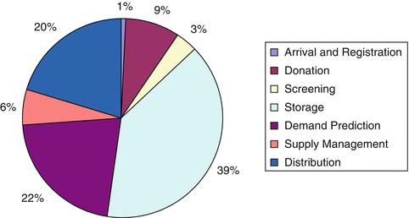
survey

Slide 7
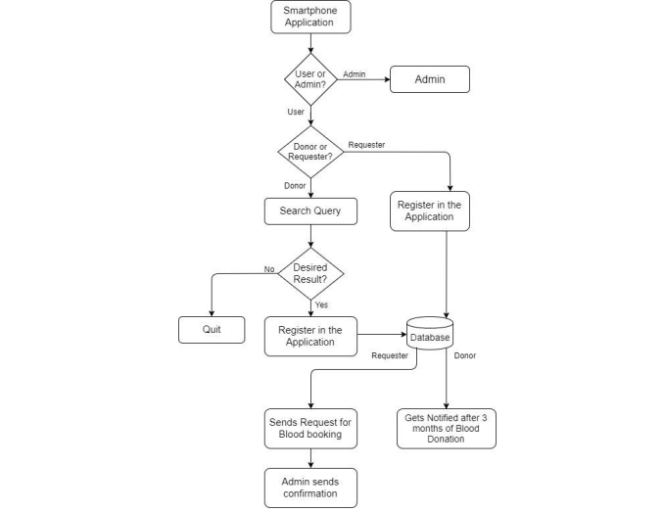
workflow

Slide 8
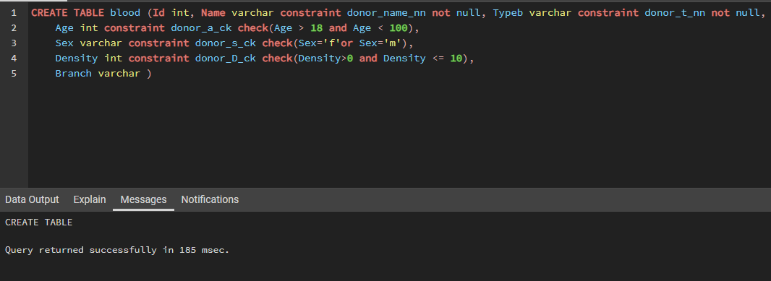
CREATE QUERY

Slide 9
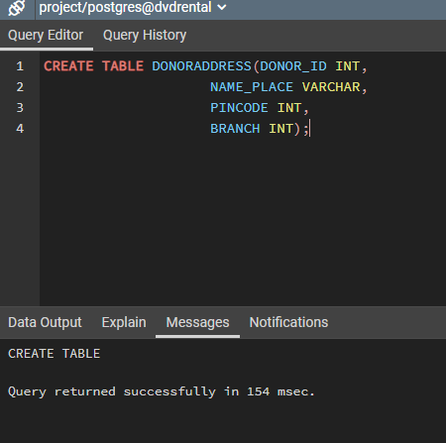

Slide 10
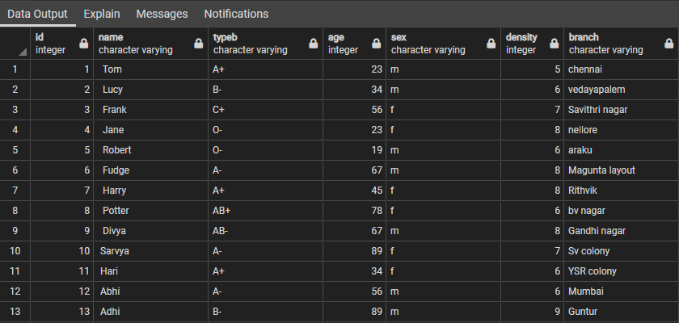
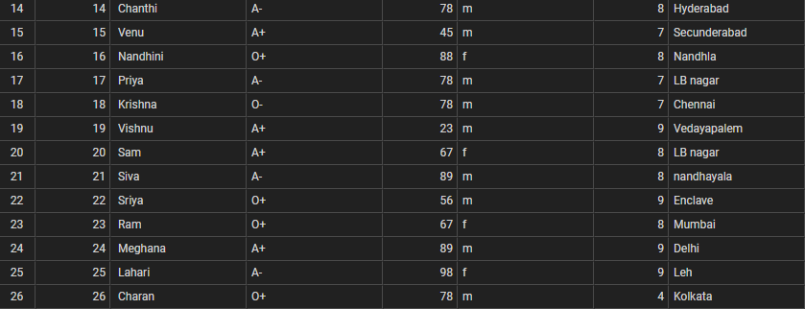
rdbms creation

Slide 11
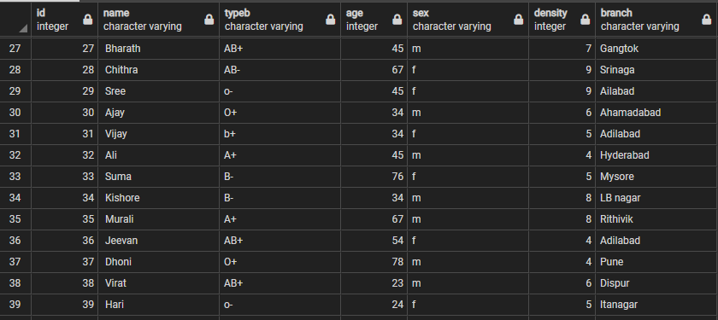
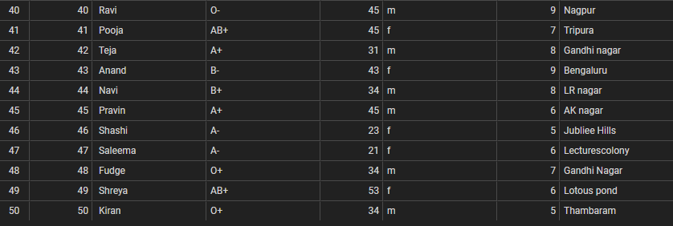
Rdbms creation

Slide 12
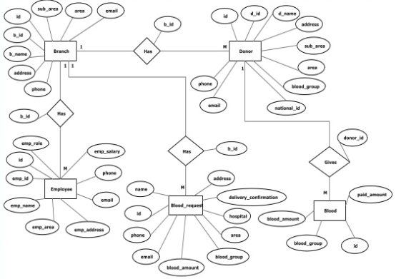
Er model

Slide 13
Functional dependencies
The Functional Dependencies for the database created are as follows:
id-> name
name->typeb
name->age
name->sex
id->density
id->branch
Here, Id is the primary key.

Slide 14
normalization
Here, we performed Normalization for :
A) Prevention of anomalies caused from Update, Insert and Delete Queries
B) Reduction of Data Inconsistency
C) Reduction of Data Redundancy
D) Converting Table to 1NF
E) Converting Table to 2NF
F) Converting Table to 3NF
Conversion happens if the tables are not in 1NF, 2NF,3NF Forms!

Slide 15
normalization
PERFORMING OPERATIONS WITH ANOMALIES:
INSERT ANOMALY:
INSERT INTO blood VALUES(null,' Sanjeev ','A- ',21,'m',6,'Lecturescolony');
UPDATE ANOMALY:
update blood set age=25 where sex='m';
DELETE ANOMALY:
delete from blood where sex='m';

Slide 16
Table in 2nf
Due to the closure of {id, name}+ involving all attributes of the relation, id and name are candidate keys.
Here, id and name are prime attributes whereas typeb, age, sex, density , branch are Non-Prime attributes.
Here, The conditions given for FDs includes Non-Prime attributes FULLY dependent on Candidate keys. So, this database is IN 2NF FORM.

Slide 17
TABLE IN 2NF
Table in 2NF has these relations:
  Blood(name, typeb)
  Blood(name, age)
  Blood(name, sex)
  Blood(id, density)
  Blood(id, branch)
  Blood(id, name)
RELATIONS LISTED ARE ALREADY IN 3NF!!!

Slide 18
Table in 3nf
Here, from the given FDs we see that Prime attributes derive Non-Prime attributes . Thus, the given database is IN 3NF form.
Table in 3NF has these relations:
Blood(name, typeb)
Blood(name, age)
Blood(name, sex)
Blood(id, density)
Blood(id, branch)
Blood(id, name)

Slide 19






TABLEs IN 2NF and 3nf
[sample OUTPUT]

Slide 20
System requirements
SOFTWARE REQUIREMENTS:
OS: Windows
Server: pgadmin 4v4
Database: PostgreSQL
HARDWARE REQUIREMENTS:
Processor: 2.4 GHz
Hard Disk: 40 GB
RAM: 2 GB

Slide 21
Target audience
Some few examples of entities that can make use of
BBMS are:
1) General Public
2) Hospitals
3) Blood Banks

Slide 22
conclusion
1) This reports presents the blood bank related issues
2) Provided database and models to the system
3) Provided solution to manage a blood bank and try to build an architecture using normalisation to avoid confusion

